Slide 1


EMPOWERMENT THROUGH EDUCATION

Slide 2

Mayo Recovery College enables people to become experts in their own self-care and develop skills and confidence to manage their own recovery
Mayo Recovery College is facilitated by both experts by experience and experts by profession. No-one is more or less important than the others
All modules are co-produced, co-delivered and co-received by staff, people with lived experience of mental health challenges and the people who are close to them.
Anyone with an interest in Mental Health & Wellbeing can attend
What is Mayo Recovery College?

Slide 3


Slide 4
AIMS OF TODAY’S WORKSHOP
This workshop will explore how Recovery Education empowers people with mental health challenges, their families/carers/supporters as well as service providers.
It will illustrate how “empowering recovery” underpins Irish Mental Health policy and identify both the benefits of and challenges to empowering people through education.

Slide 5

WHAT IS EMPOWERMENT?
Empowerment is defined as “the process of becoming stronger and more confident, especially in respect to having control over your own life and having your needs and rights respected”.

Slide 6
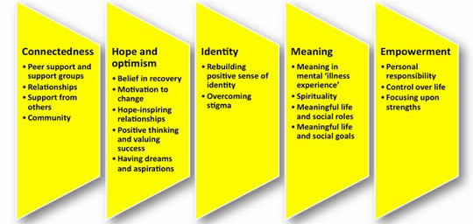
Notes:
Empowerment is one of the key processes for personal recovery

Slide 7
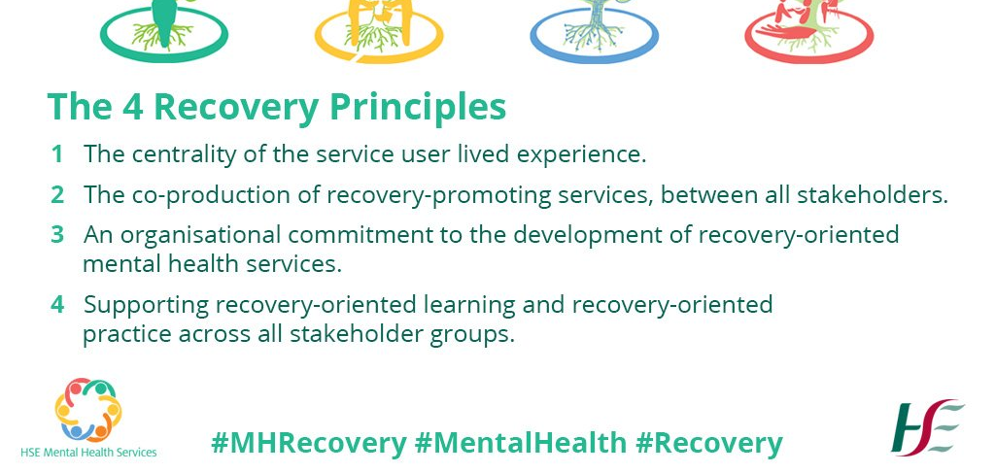
Notes:
Supporting Recovery Oriented Learning is one of the key principles of our National Framework

Slide 8

WHAT IS RECOVERY EDUCATION?
Recovery Education is the process by which individuals explore, assimilate and create the knowledge required for recovery to occur in their own lives or in the lives of those they support or provide services to

Slide 9

HOW DOES IT EMPOWER?
Recovery Education empowers people with mental health challenges, their families/supporters and service providers by helping them gain a better understanding of the essential processes of recovery.
By using Adult Education Methodologies such as self-directed learning, valuing the persons own lived experience and incorporating different learning styles and collaborative learning Recovery Education respects the person’s individual recovery journey as well as liberating the person from the stigma that can often surround mental health challenges

Slide 10
How else does it empower?
Enrolment rather than referral
Facilitated discussion amongst Persons with Lived Experience, Family members/Supporters and Service Providers rather than lecture
Provision of a safe, non-judgemental environment
Equality, Respect and Non-Judgemental Acceptance
All classes are co-produced and co-facilitated by People with Lived Experience, Family Members/Supporters and Service Providers

Slide 11
RECOVERY COLLEGES IN IRELAND-A BRIEF HISTORY
Recovery College Concept began in USA in 1990’s.
Early naughties Several Recovery Colleges established in UK (specifically Nottingham)
2011 Mayo Rehabilitation/Recovery team visited these colleges
2012 GENIO funding for 1 year Peer Support Project
HSE funding
Mayo the first in Ireland in 2013 situate in the old St. Mary’s psychiatric hospital (1866-2006) which is now the Galway Mayo Institute of Technology
10 Recovery Colleges nationwide

Slide 12


GROUP WORK
WHAT DO YOU THINK ARE THE CHALLENGES TO PROVIDING RECOVERY EDUCATION?
HOW DO YOU THINK RECOVERY EDUCATION EMPOWERS PEOPLE?

Slide 13

QUESTIONS

Slide 14
Please click the link below to join the webinar:
https://us02web.zoom.us/j/85133436786
TO GET BACK TO MAIN SEMINAR

