Slide 1

European Network of (ex-)Users and Survivors of Psychiatry (ENUSP)
E-mail: enusp.info@gmail.com Website: www.enusp.org
Workshop:“Empowering Recovery - A Human Rights Based Approach”
“How our involvement in monitoring human rights in psychiatry is a State obligation and can lead to change”
Ms. Olga Kalina

Slide 2
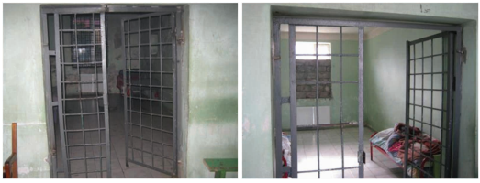
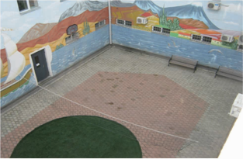
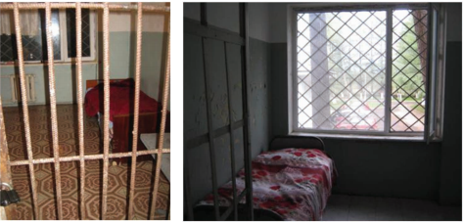
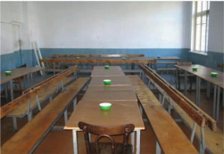
http://www.ombudsman.ge/uploads/other/3/3694.pdf

Slide 3
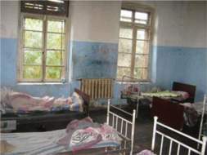
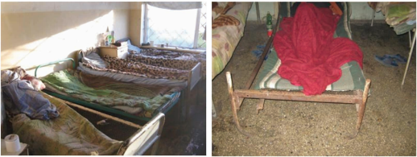
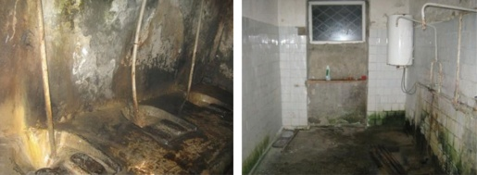
http://www.ombudsman.ge/uploads/other/3/3694.pdf

Slide 4
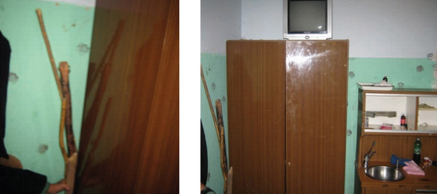
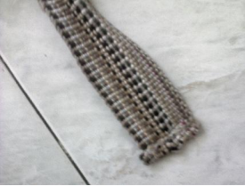
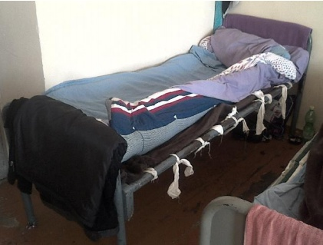
Sticks and means of mechanical restraint
http://www.ombudsman.ge/uploads/other/3/3694.pdf
http://www.ombudsman.ge/uploads/other/1/1726.pdf

Slide 5
Different monitoring mechanisms
Internal monitoring (by Ministry of Healthcare, for example)
Quality Rights monitoring, by WHO https://www.who.int/mental_health/publications/QualityRights_toolkit/en/
Independent monitoring by Civil Society, including organizations of people with lived experience (can use various tools and check various things)
Monitoring under UN CRPD, Article 33
Monitoring visits in these cases usually have to be agreed with the institution or with the government

Slide 6
Article 33 of the UN CRPD
1. States Parties, in accordance with their system of organization, shall designate one or more focal points within government for matters relating to the implementation of the present Convention, and shall give due consideration to the establishment or designation of a coordination mechanism within government to facilitate related action in different sectors and at different levels.
2. States Parties shall, in accordance with their legal and administrative systems, maintain, strengthen, designate or establish within the State Party, a framework, including one or more independent mechanisms, as appropriate, to promote, protect and monitor implementation of the present Convention. When designating or establishing such a mechanism, States Parties shall take into account the principles relating to the status and functioning of national institutions for protection and promotion of human rights.
3. Civil society, in particular persons with disabilities and their representative organizations, shall be involved and participate fully in the monitoring process.

Slide 7
CPT and SPT
Сouncil of Europe Committee for the Prevention of Torture and Inhuman or Degrading Treatment or Punishment (CPT). Scheduled visits in 2020: Azerbaijan, Finland, Germany, Monaco, Serbia, Spain, Sweden. Ad hoc visits.
The CPT was set up under the Council of Europe’s “European Convention for the Prevention of Torture and Inhuman or Degrading Treatment or Punishment”, which came into force in 1989 and has been ratified by 47 members of CoE.
www.cpt.coe.int
The UN Subcommittee on Prevention of Torture and other Cruel, Inhuman or Degrading Treatment or Punishment (SPT)-operating under the Optional Protocol of the Convention against Torture and Other Cruel, Inhuman, or Degrading Treatment or Punishment, (OPCAT), 1987 https://www.ohchr.org/EN/HRBodies/OPCAT/Pages/OPCATIntro.aspx

Slide 8
SPT and NPMs
If the State party refuses to co-operate or fails to take steps to improve the situation in light of the SPT’s recommendations, the SPT may request the Committee against Torture to make a public statement or to publish the SPT report if it has not yet been made public.
National Prevention Mechanisms (NPMs). According to Article 17 of the OPCAT, State Parties have an obligation to establish NPMs, which are independent national bodies for the prevention of torture and ill treatment at the domestic level. (OPCAT is not ratified by Ireland, Slovakia, Belgium, Belarus, Latvia, Russian Federation).
https://www.ohchr.org/EN/HRBodies/OPCAT/Pages/NationalPreventiveMechanisms.aspx

Slide 9
Universal Periodic Review
The Universal Periodic Review (UPR) is a mechanism of the United Nations (UN) Human Rights Council (HRC) that emerged from 2005. Commonly referred to as the UN-UPR, it was established by General Assembly resolution 60/251 of 3 April 2006, the UN-UPR periodically examines the human rights performance of all 193 UN Member States.
There is a number of opportunities for non-governmental stakeholders to get involved. These include:
Participating in national consultations for the preparation of a State's national report.
Submitting information to State reviews.
Attending the review of the State at the Working Group on the UPR.
Attending the HRC session at which the outcome report on a State is adopted. ‘A’ status NHRIs and ECOSOC-accredited NGOs may make ‘general comments’ before the adoption of the outcome report
When appropriate, working on the follow-up of UPR recommendations

Slide 10
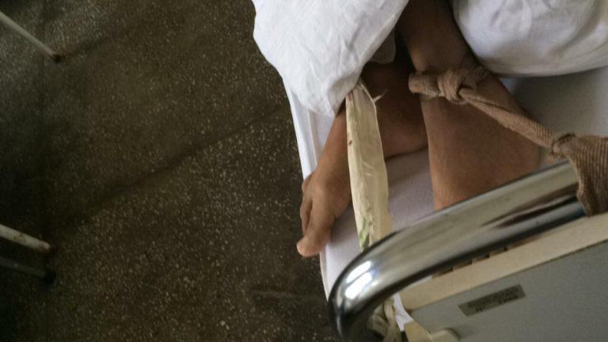
Rehabilitation Center for People with Disability, Romania, 2019

Slide 11
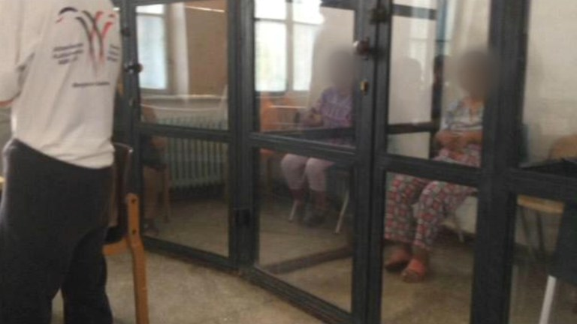
Rehabilitation Center for People with Disability, Romania, 2019

Slide 12
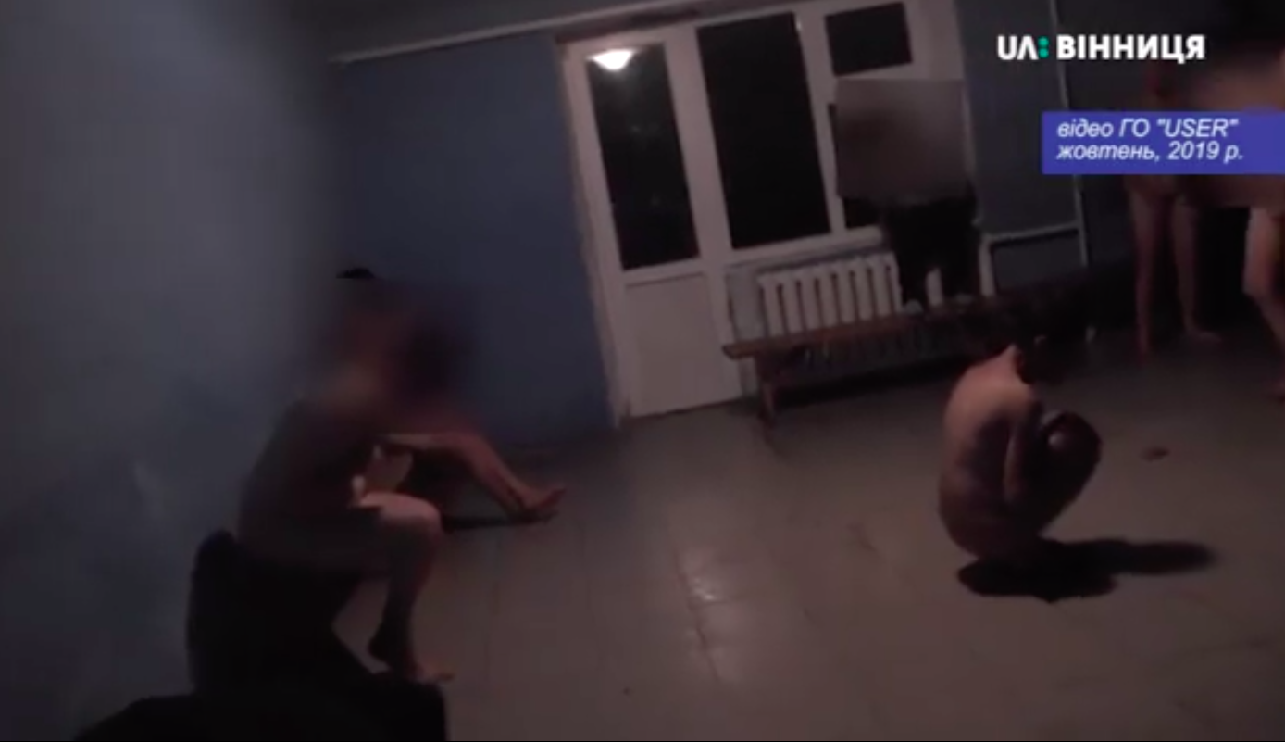
Ukraine, residential facility, October 2019

Slide 13
We need to take action
Report about violations of rights that you witness or experience/have experienced
Try to find a monitoring body/bodies in your country and influence them.
Try to join an existing monitoring team, or create your own
Try to not be silenced by the powerful others in the process

Slide 14


