Slide 1

Peer Workers as Catalysts for Service User Empowerment within their Individualised Recovery Journey.
Michael John Norton & Feargus Callagy
Mental Health Europe Empowerment Webinar
Friday 24th July 2020
Notes:
5 Mins

Slide 2

Support Agreement
Notes:
5 Mins

Slide 3

Objectives
A better understanding of peer work
An appreciation of how peer workers support empowerment in ones’ recovery journey.
Notes:
2 Mins

Slide 4
Empowerment Definition
According to the World Health Organization, patient empowerment is “a process through which people gain greater control over decisions and actions affecting their health.
According to Rappaport (1985) , empowerment is a sense of control over one's life in personality, cognition and motivation.
Notes:
10 Mins

Slide 5
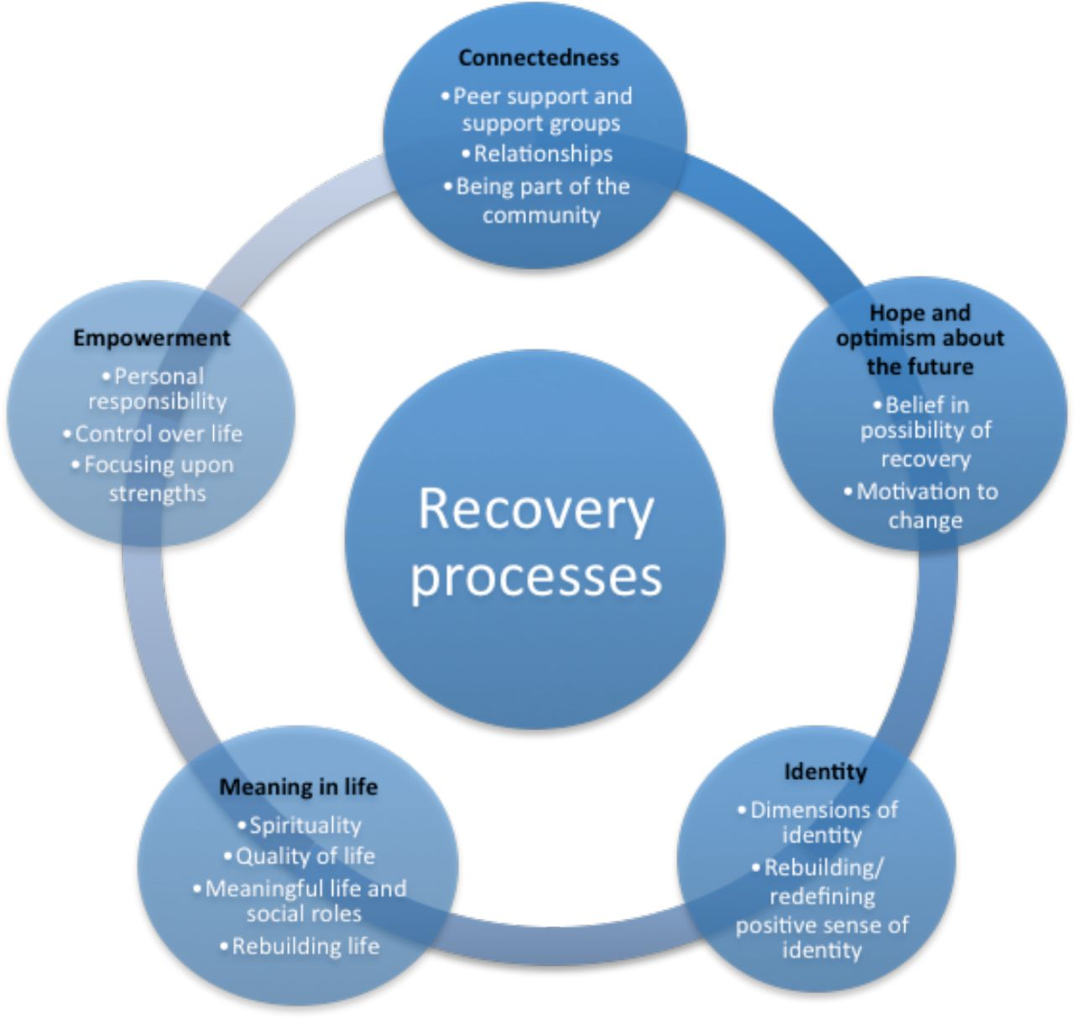
CHIME Model Leamy et al. (2011)
Notes:
5 Mins

Slide 6

What is your understanding of the term peer work?
Notes:
10 Mins

Slide 7
Peer Work – A Definition
No universal definition to peer work.
A process by which those with lived experience of mental health/addiction challenges utilise, in a structured/informal manner, the knowledge they acquired during their recovery journey [experiential knowledge] to inform and support others recovery/knowledge of recovery.
https://www.youtube.com/watch?v=F1X2cda1BUc
Notes:
10 Mins

Slide 8
Types of Peer - Job Titles
Peer Support worker (Private/Public)
Peer Educator
Peer specialist (addiction, chronic illness, forensic)*
Family Peer
Consumer Academic
Notes:
3 Mins

Slide 9

How does peer work facilitate empowerment on ones’ recovery journey?
Notes:
10 Mins – 10 Mins

Slide 10

Feargus’s Story
Notes:
10 Mins

Slide 11

What's your experience of being empowered ?
Notes:
10 Mins

