Slide 1


Mental Health Promotion
Exploring its Vision
Anne Sheridan
Programme Manager Mental Health and Wellbeing
HSE
Aisling Doherty
Mental Health Promotion Manager
Mental Health Ireland

Slide 2
Overview
Sharing The Vision - Promotion, Prevention & Early Intervention Domain
  National Mental Health Promotion Plan
HSE Mental Health Promotion Plan

Slide 3
Mental Health Promotion
Levels
Reduce Structural Barriers
Strengthen Communities
Strengthen Individuals
Compelling evidence that the promotion of mental health leads to lasting benefits for the improved health and wellbeing of individuals, their families and society (WHO, 2013).

Slide 4
Sharing A Vision - Promotion, Prevention & Early Intervention Domain
Lifecycle Approach – Key Actions:
  First 5; A Whole of Government Strategy
  Schools: Wellbeing Framework (2018-2023) – Whole School approach
  National Youth Mental Health Task Force
  Healthy Ireland Workplace Framework
  Stigma Reduction campaigns & Priority Groups
  National Mental Health Promotion Plan
    “framework of reference and the overarching context for all mental health promotion and campaign activity in Ireland” (Sharing the Vision, 2020)

Slide 5
National Mental Health Promotion Plan
Youth:
Preschool Education & Universal Parenting Programme
Social and Emotional Learning (SEL) Programmes
Working Aged:
Stress Management Programmes & Workplace Mental Health Policies
Older Adults & Priority Groups
Community participation programmes
Social Prescribing
Virtual communities

Slide 6
Mental Health Promotion in our Health Services
  Promote Recovery Initiatives
  Mental health promotion training for healthcare workers
  Healthy Cities/Communities Initiatives
  ThriveLDN/ThriveNYC
Mental Health Proofing our Policies
  Opportunity with this plan

Slide 7





National Mental Health and Wellbeing Indicators
  Next?

Slide 8
HSE Mental Health Promotion Plan
Background & development process
  The Vision
  The Goals
  Action Themes
  Engagement and Consultation

Slide 9
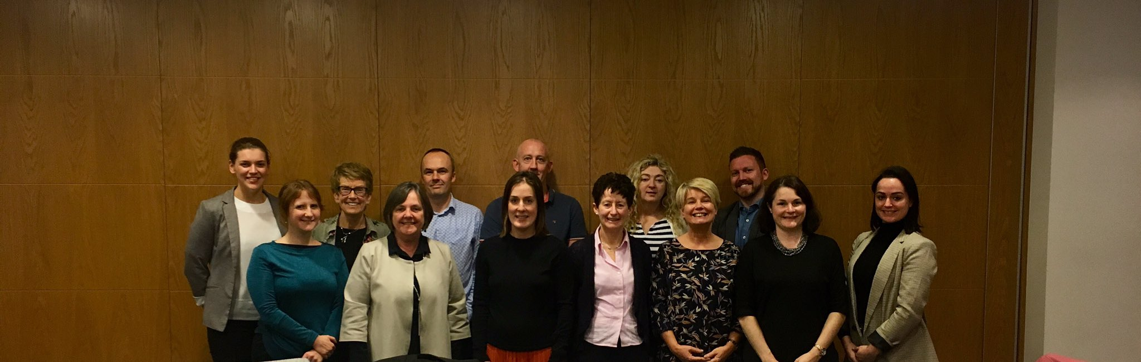
HSE Mental Health Promotion Plan
National Working Group
CES consultation support & academic/research support

Slide 10
The Vision
A Health Service where service users, staff and the general public can enjoy mental health and wellbeing to our full potential and where mental health and wellbeing is valued and supported at every level of the organisation.

Slide 11
The Goals
Increase the proportion of people who are mentally healthy at all life stages.
Reduce inequities in mental health and wellbeing.
Mainstream the promotion of mental health and wellbeing within the HSE and funded agencies.
1
2
3

Slide 12
Action Themes
1. Promote positive mental health & wellbeing of:
  children & young people in homes, community and education settings;
  adults & older people in community & workplace settings;
  priority groups.
2. Build capacity of the HSE to promote mental health and wellbeing
3. Work with the wider system (Government/C&V sectors and Local Authorities) on enable the promotion of mental health and wellbeing

Slide 13



Moving Towards Consultation and Engagement
Stage 1 Discussion of draft action areas and emerging priorities with groups of stakeholders
Stage 2 Challenge panels to refine, test feasibility and practicality of actions for implementation
Stage 3 Feedback on draft Mental Health Promotion Plan from key stakeholders

Slide 14
Thank you for listening.

Slide 15
References
World Health Organisation. (2013). Investing in mental health evidence for action. Geneva, Switzerland: World Health Organisation.

