Slide 1
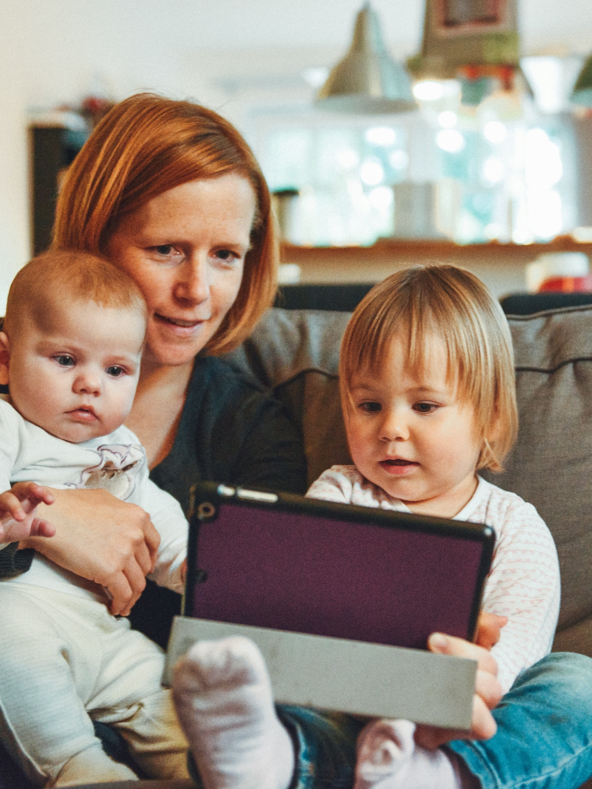

Mental Health Ireland
Home Schooling
March 2021
Job No: 502421

Slide 2

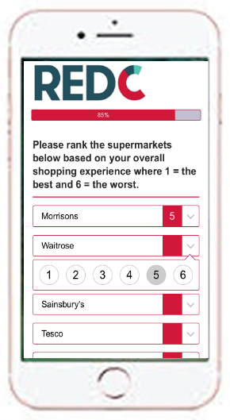

RED Line Methodology
Gender
Age
  Online research was conducted with 1,028 ROI adults aged 18+.
  The target group for this research however was a sub group of parents who are currently home-schooling children ages 4+.
  234 adults fitting this criteria were identified within this data, suggesting the incidence of the group in the Irish population is 23%.
  However in order to ensure a robust sample for deep diving this subgroup, the sample was boosted by a further 164 achieving a final total sample of n=398.
  Respondents were recruited using RED C Live, RED C’s own online panel of over 40,000 members
  Quota controls were used to ensure a nationally representative sample of ROI adults aged 18+, with interlocking quotas to provide extra confidence in sample profile
  Data was weighted across Gender, age, region and social class so as to ensure a nationally representative sample based on latest CSO projections
  Fieldwork for this research took place from 19th – 24th February 2021
  Shortly before this research was conducted, the government announced their plan for the phased re-opening of schools.
51%
49%
Social Class
Region
Conn/ Ulster
17%
Dublin
29%
50%
44%
Rest of Leinster 27%
Munster
27%
ABC1
C2DE

Slide 3
Profile of Home Schoolers
01

Slide 4

1 in 4 people in Ireland are home schooling their children
Proportion of People in Ireland who are Home Schooling
Ages of Children in the Household
0-3
4-5
6-12
13-15
16-18
19+
23%
are home schooling children

Slide 5
This aged 35-54 most likely to be home schooling
Demographic split of total population versus those home schooling
Total Population
Those Home-Schooling
Gender
Age Group
Social Class
Region

Slide 6
3 in 10 of those who are home schooling are doing so while managing a full time job at home. A further 1 in 3 are still leaving for work, but having to home school after wards.
Working Situation
Working from home full-time (30+hrs pw)
Working from home part time (15-29 hrs pw)
Working from home part time (less than 15 hours a week)
Not working from home, I leave the house for work
Not working

Slide 7
8 in 10 home-schooling up to four hours a day
This is rises more significantly amongst those with children over the age of 6.
Time devoted to school work every day
Age of Children
Total
4-5
6-12
13-15
16-18
19+
7 hours or more
5-6 hours
3-4 hours
1-2 hours
Less than 1 hour

Slide 8
Home School Supports
02

Slide 9
Rural areas are less likely to have reliable, sufficient broadband
1 in 4 disagree that they have enough devices for school and work needs; 1 in 3 don’t believe they have affordable internet or that home-schooling is incorporating time for social development.
Home-schooling Supports
Our household has reliable broadband that is sufficient for the current demands on it | There are sufficient computer devices to cater for the home school and working from home demands of our household | Our home-schooling includes live / interactive sessions with teachers/tutors | Our household has affordable broadband that is sufficient for the current demands on it | Our home-schooling teacher/school incorporates time for social development
NET: Agree
Rural: 68%
vs Urban: 81%
78% | 74% | 73% | 69% | 59%
Agree strongly
Agree slightly
Disagree slightly
Disagree strongly
NET: Disagree
Rural: 31%
vs Urban: 18%
22% | 25% | 26% | 31% | 32%
1% | 2% | 1% | 1% | 9%
Don’t know

Slide 10
The older the children, the less time for social development
Interactive sessions significantly less likely among those with younger children.
Conditions of home-schooling x Age of children
Our home-schooling includes
live / interactive sessions
with teachers/tutors
Our home-schooling teacher/school incorporates time for social development
These statements show the greatest difference depending on age of children.
Other statements show less differentiation.
Total
4-5
6-12
13-15
16-18

Slide 11
Interactive platforms are deemed most effective by parents
Emailed homework and pre-recorded lessons online are seen to be far less effective as a means of home schooling. It’s also clear that different platforms appeal to different age groups.
Most beneficial amongst children aged:
Home-schooling method considered most effective
4-5: 30%
6-12: 35%
13-15: 36%
16-18: 35%
19+: 31%
19+: 13%

Slide 12
General Attitudes of Home Schoolers
03

Slide 13
3 in 4 parents believe their child needs supervision
Many also question their personal efforts and feel a strain at times on the relationship due to home-schooling, higher in rural areas. Still 3 in 5 feel more connected to their child.
Impact of home-schooling on children & parents
My child/children sometimes struggles to apply themselves to the work without (…) supervision | I often wonder if I/we are doing as well as other parents at Home Schooling | Home schooling has at times put a strain on the relationship I have with my child/children | I feel more connected to my child/children as a result of the need for home schooling
NET: Agree
1-2 hours/day: 78%
vs 3-4 hours/day: 66%
Rural: 65%
vs Urban: 54%
77% | 69% | 62% | 61%
Agree strongly
Agree slightly
Disagree slightly
Disagree strongly
NET: Disagree
1-2 hours/day: 19%
vs 3-4 hours/day: 28%
Rural: 33%
vs Urban: 46%
22% | 26% | 37% | 34%
1% | 5% | 2% | 5%
Don’t know

Slide 14
Over half say computer gaming can be a distraction to children
Social media is also a distraction for over 2 in 5 parents and children.
Statements about home-schooling
Computer gaming can be a distraction to my child/children when I am trying to home school | My child/children get distracted sometimes by social media such as Instagram, Twitter etc. | Social Personal Health Education, mental health and wellbeing have been incorporated as an integral feature of the Home Schooling through our school/teacher
NET: Agree
Children 13-18: 61%
vs Children 4-12: 34%
56% | 45% | 43%
Agree strongly
Agree slightly
Disagree slightly
Disagree strongly
NET: Disagree
41% | 52% | 45%
3% | 3% | 12%
Don’t know

Slide 15
4 in 10 parents agree they get distracted by social media
1 in 3 parents claim their work performance has suffered as a result of home schooling. Almost two thirds claim their children have had no opportunity to interact with members outside immediate family.
Statements about home-schooling
I get distracted sometimes from home schooling by social media such as Instagram, Twitter etc. | My work performance has suffered while trying to Home School | My child/children have had an opportunity to meet with or see other children outside of the immediate family during this lockdown
NET: Agree
41% | 35% | 34%
Agree strongly
Agree slightly
Disagree slightly
Disagree strongly
NET: Disagree
54% | 51% | 65%
4% | 13% | 1%
Don’t know/N/A

Slide 16
Challenges Facing Home Schoolers
04

Slide 17

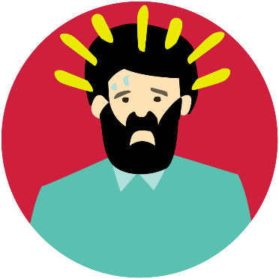
Vast majority feel that their stress level increased over lockdown
1 in 3 claiming it has been to a ‘much higher’ stress level than before.
Change in stress levels during period of lockdown
NET: Higher
78%
Much Higher Stress Level
Slightly Higher Stress Level
No change
16%
Slightly Lower Stress Level
Much Lower Stress Level
NET: Lower
6%

Slide 18
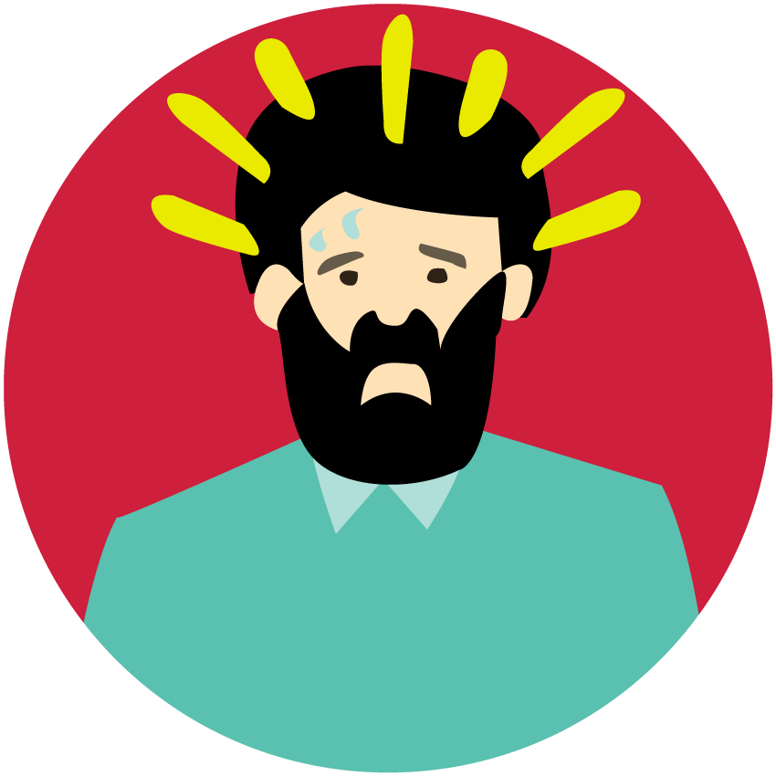
Balancing work, home-schooling and housework is main challenge
Particularly for those of higher social classes and with younger children. Parents who home-school for 1-2 hours/day are more likely to find staying focused the most stressful aspect.
Most stressful aspect of home-schooling
ABC1: 46%
vs C2DE: 28%
Children 4-12: 41%
vs Children 13-18: 31%
Balancing everything that needs to be done from work, home schooling, housework etc.
Staying focused
Getting started - i.e. getting children ready to start home schooling
Unfamiliar material
Complex subjects and course work
Submitting finished work (via email /scanning / photos)
Meeting deadlines
Other
None of these, I don't find home schooling stressful
1-2 hours/day: 27%
vs 3-4 hours/day: 14%
Children 13-18: 10%
vs Children 4-12: 5%

Slide 19
2 in 5 parents home-schooling are sleeping and exercising less
1 in 5 say their alcohol consumption has increased.
How home-schooling has changed habits & life style
Diet | Sleep | Alcohol | Exercise | Drug use
Has increased
Has stayed the same
54% | 49% | 43% | 32% | 6%
Has decreased
Not applicable
4% | 2% | 26% | 2% | 92%

Slide 20
COVID-19 and financial worries are the most demanding issues
Parenting and home-schooling demands come next and ahead of work demands as more challenging.
Most challenging issue in the current climate
Anxieties relating to Covid–19 | Financial Worries | Home Schooling Demands | Parenting Demands | Work Demands
1 - Most demanding
2nd
3rd
4th
5 - Least demanding

Slide 21
Key Findings
1
2
3
Just under 1 in 4 people in Ireland are devoting time to home schooling, with the highest proportion being with children aged 6-12, devoting between 1-4 hours every day.
The majority believe their broadband is reliable and they have enough devices to support their needs. However for circa 1 in 4, this is not the case (particularly in rural areas).
There appears, for some, to be a real lack of wider engagement; 1 in 3 claim there is no time for social development put aside by the school/teacher, 1-4 claiming there is no interactive sessions and 45% claim mental health and wellbeing have NOT been incorporated as a feature of the Home Schooling.
4
5
6
A high proportion (69%) express self doubt as they compare themselves to other parents. Furthermore, 62% feel a strain has been put on the child's relationship as a result of home-schooling. However there has been some positives as 6 in 10 feel more connected to their children as a result of home schooling.
Computer games, and social media are seen to be a distraction for children, but also parents. 45% claim their children get distracted by social media, while a similar proportion, 41% claim they get distracted by themselves.
Stress levels during lockdown have been significant, with 78% claiming their stress levels have increased, with the difficulty of balancing everything that needs to be done at the core of this stress.

Slide 22
Core questions split by social class and urban/rural residence
Q.4 Most effective home schooling platform | Total Sample | ABC1 | C2DE | Urban | Rural
Base | 398 | 204 | 190 | 278 | 120
Seesaw | 25% | 24% | 26% | 25% | 26%
Live Lessons online | 24% | 27% | 22% | 24% | 23%
Zoom | 19% | 19% | 19% | 22% | 13%
Emailed homework | 8% | 8% | 8% | 6% | 12%
Pre-recorded lessons online | 7% | 3% | 9% | 5% | 9%
Projects or assignments | 4% | 6% | 3% | 4% | 3%
Dojo | 3% | 2% | 3% | 3% | 2%
RTE School Hub | 1% | 2% | - | 1% | -
Other | 3% | 3% | 3% | 2% | 6%
None of these are helpful | 6% | 6% | 6% | 7% | 4%
Q.6 Most stressful aspect of home schooling | Total Sample | ABC1 | C2DE | Urban | Rural
Base | 398 | 204 | 190 | 278 | 120
Balancing everything that needs to be done from work, home schooling, housework etc. | 37% | 46% | 28% | 36% | 38%
Staying focused | 19% | 18% | 20% | 18% | 21%
Getting started - i.e. getting children ready to start home schooling | 10% | 10% | 11% | 11% | 9%
Unfamiliar material | 9% | 10% | 8% | 10% | 7%
Complex subjects and course work | 6% | 5% | 8% | 6% | 7%
Submitting finished work | 5% | 2% | 7% | 6% | 2%
Meeting deadlines | 4% | 2% | 6% | 5% | 1%
Other | 3% | 4% | 2% | 3% | 1%
None of these, I don't find home schooling stressful | 8% | 4% | 10% | 6% | 14%
Q.9 Impact of Covid-19 lockdown on stress levels | Total Sample | ABC1 | C2DE | Urban | Rural
Base | 398 | 204 | 190 | 278 | 120
NET: Higher | 78% | 83% | 75% | 81% | 71%
Much Higher Stress Level (5) | 33% | 32% | 35% | 36% | 27%
Slightly Higher Stress Level (4) | 45% | 51% | 40% | 45% | 44%
No change (3) | 16% | 12% | 18% | 13% | 23%
Slightly Lower Stress Level (2) | 4% | 4% | 5% | 5% | 3%
Much Lower Stress Level (1) | 2% | 1% | 3% | 2% | 3%
NET: Lower | 6% | 5% | 7% | 6% | 6%

Slide 23
Core questions split by social class and urban/rural residence
Statement |  | Total Sample | ABC1 | C2DE | Urban | Rural
Base Size |  | 398 | 204 | 190 | 278 | 120
Q.3 There are sufficient computer devices to cater for the home school and working from home demands of our household | Net Agree | 74% | 75% | 73% | 75% | 69%
 | Net Disagree | 25% | 24% | 24% | 22% | 30%
Q.3 Our household has reliable broadband that is sufficient for the current demands on it | Net Agree | 78% | 81% | 76% | 81% | 68%
 | Net Disagree | 22% | 18% | 24% | 18% | 31%
Q.3 Our household has affordable broadband that is sufficient for the current demands on it | Net Agree | 69% | 73% | 65% | 71% | 63%
 | Net Disagree | 31% | 27% | 34% | 29% | 36%
Q.3 Our home-schooling includes live / interactive sessions with teachers/tutors | Net Agree | 73% | 75% | 73% | 76% | 67%
 | Net Disagree | 26% | 23% | 26% | 23% | 32%
Q.3 Our home-schooling teacher/school incorporates time for social development such as unstructured engagement, ... and sustaining school-based friendship | Net Agree | 59% | 59% | 59% | 60% | 57%
 | Net Disagree | 32% | 33% | 31% | 30% | 37%
Q.5 Home schooling has at times put a strain on the relationship I have with my child/children | Net Agree | 62% | 63% | 62% | 65% | 54%
 | Net Disagree | 37% | 35% | 37% | 33% | 46%
Q.5 I often wonder if I/we are doing as well as other parents at Home Schooling | Net Agree | 69% | 70% | 68% | 70% | 66%
 | Net Disagree | 26% | 26% | 26% | 25% | 29%
Q.5 My child/children sometimes struggles to apply themselves to the work without prompting, continual encouragement, one-to-one supervision | Net Agree | 77% | 81% | 73% | 77% | 78%
 | Net Disagree | 22% | 17% | 27% | 22% | 22%
Q.5 I feel more connected to my child/children as a result of the need for home schooling | Net Agree | 61% | 58% | 64% | 62% | 57%
 | Net Disagree | 34% | 39% | 31% | 32% | 40%

Slide 24
Core questions split by social class and urban/rural residence
Statement |  | Total Sample | ABC1 | C2DE | Urban | Rural
Base Size |  | 398 | 204 | 190 | 278 | 120
Q.10 Social Personal Health Education, mental health and wellbeing have been incorporated as an integral feature of the Home Schooling through our school/teacher | Net Agree | 43% | 43% | 43% | 45% | 38%
 | Net Disagree | 45% | 46% | 44% | 41% | 55%
Q.10 I get distracted sometimes from home schooling by social media such as Instagram, Twitter etc. | Net Agree | 41% | 45% | 38% | 43% | 38%
 | Net Disagree | 54% | 52% | 57% | 52% | 59%
Q.10 My child/children get distracted sometimes by social media such as Instagram, Twitter etc. | Net Agree | 45% | 47% | 41% | 46% | 41%
 | Net Disagree | 52% | 48% | 56% | 50% | 56%
Q.10 Computer gaming can be a distraction to my child/children when I am trying to home school | Net Agree | 56% | 60% | 52% | 60% | 45%
 | Net Disagree | 41% | 37% | 45% | 36% | 54%
Q.10 My work performance has suffered while trying to Home School | Net Agree | 35% | 47% | 25% | 39% | 26%
 | Net Disagree | 51% | 44% | 59% | 47% | 63%
Q.10 My child/children have had an opportunity to meet with or see other children outside of the immediate family during this lockdown | Net Agree | 34% | 31% | 37% | 37% | 27%
 | Net Disagree | 65% | 68% | 62% | 61% | 73%

