Slide 1
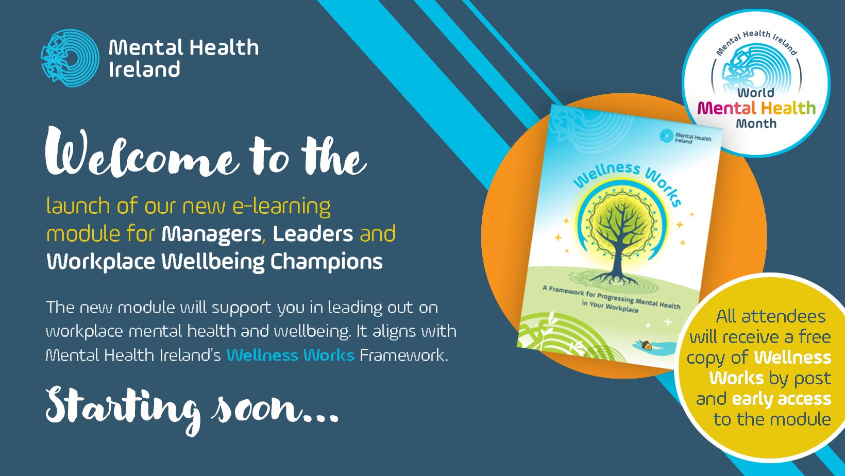

Slide 2
Coming Up...
12.00 Welcome and Introduction to Workplace Mental Health and Wellbeing
12.05 Mental Health – Corey Keyes - Flourishing vs languishing
12.10 Reflection from Employees
12.15 The latest research on Workplace Mental Health and Wellbeing
12.25 Introduction to the new e-Learning Module & Organisational Readiness
12.30 Overview of the Module - Content, Access & Further Resources
12.40 Q&A
Catherine Brogan, Deputy CEO, Mental Health Ireland, President, Mental Health Europe
Martin Rogan, CEO, Mental Health Ireland
Various
Shane McHale, Training & e-Mental Health, Mental Health Ireland
Shane McHale, Training & eMental Health, Mental Health Ireland
Daniela Monza, Education, Training & e-Mental Health Officer

Slide 3

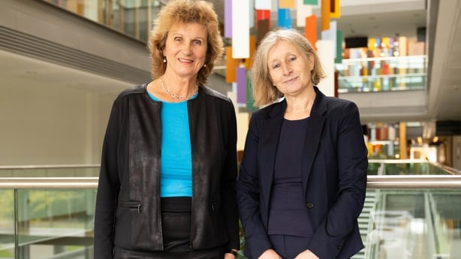


'Work related causes of mental health conditions (challenges) and interventions for their improvement in workplaces'
Dr Birgit Greiner and Professor Ella Arensman from the UCC School of Public Health, co-authored this major scientific study article with academics from universities in Europe, Japan and Australia.
The Lancet is a weekly peer-reviewed general medical journal and one of the oldest of its kind. It is also the world's highest-impact academic journal.
The World Health Summit is a unique science-led international strategic forum for global health. It brings together stakeholders from politics, science, the private sector, and civil society from around the world to set the agenda for a healthier future by inspiring innovative solutions for better health and wellbeing for all.
https://www.thelancet.com/journals/lancet/article/PIIS0140-6736(23)00869-3/fulltext

Slide 4
The publication highlights the link between exposure to adverse working conditions and the risk of various types of depression.
The global study finds that mental health challenges are common in the working population.
Researchers cite at least 15% of adults of working age experience mental health challenges, with depression, anxiety and substance abuse being the most common. (Remember Martin's presentation?)
Workers with mental health challenges are at increased risk of sickness absence, unemployment, permanent exit from employment and lower lifetime income, which in turn can exacerbate mental health challenges.
The study finds that most interventions focus on the individual level only and recommends that more proactive interventions need to be developed to protect and promote workers' mental health and wellbeing.
High Level Findings

Slide 5
"Workplaces have huge potential to influence mental health by promoting the positive aspects of work and providing safe, non-discriminatory support for those showing signs of mental health challenges," Dr Greiner said.
"Modifying psychosocial working conditions is key. Workplace mental health should be made a collective concern at all levels of an organisation," she added.
Prof Arensman said that "work-related mental health is an issue of public health importance".
"We know burnout and distress are common particularly within the healthcare sector, leading to difficulties in attracting new workers, their retention and turnover," she said.
"Interventions must include the prevention of mental health challenges along with helping affected individuals regardless of cause," she added.
Author Comments

Slide 6
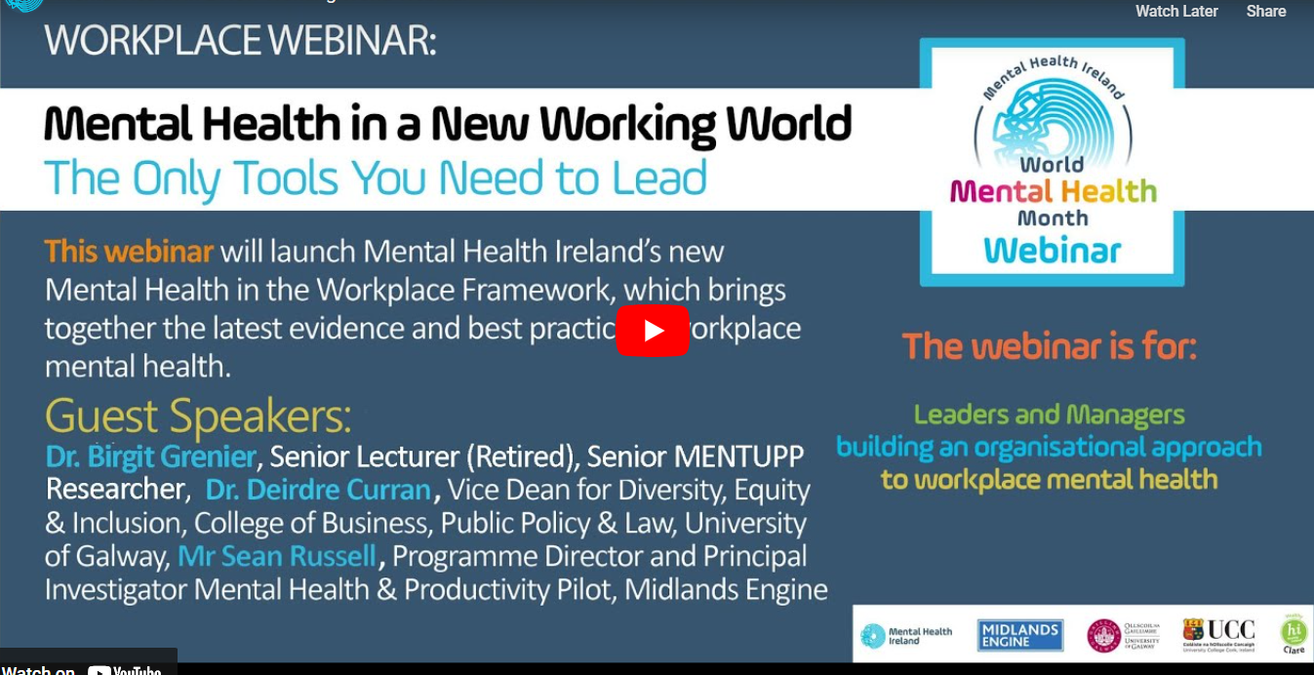

Last Year's Webinar:
Dr. Birgit Greiner
https://worldmentalhealthmonth-mhi.ie/get-involved/national-wmhm-webinar/

Slide 7
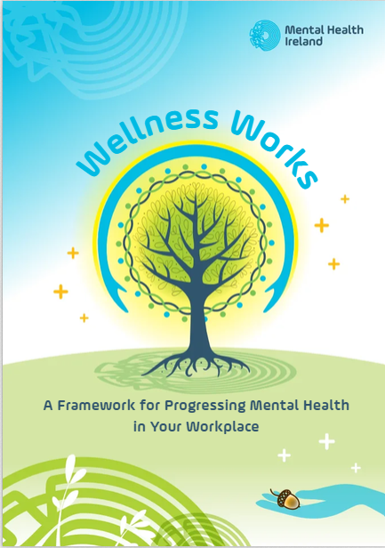
'Wellness Works' Framework
Who is it for?
This Framework is for employers and leaders in all types of workplaces who want to champion and support mental health as a core priority within their organisation.
It is also for employees within workplaces who will work together with their workplace leaders to implement best practices in the area of mental health.

Slide 8
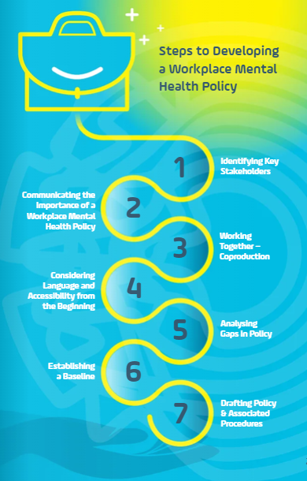
What is it?
A roadmap
Every workplace is different, and the policy guidance included in the framework is intended to help employers take the first steps in developing their own Workplace Mental Health Policy.
It should be adapted and tailored to suit the needs of your organisation.

Slide 9
Workplace Mental Health & Wellbeing resources by Mental Health Ireland
'Your First Steps Towards Mental Health & Wellbeing in the Workplace' e-Learning Module
https://www.mentalhealthireland.ie/elearning/login/
'Wellness Works' framework
'Mental Health in a New Working World. The Only Tools You Need to Lead' webinar
https://worldmentalhealthmonth-mhi.ie/get-involved/national-wmhm-webinar/

Slide 10
Organisational Readiness:
The McKinsey 7s Framework
The Hard S’s:
Structural
Strategic
Systematic
The Soft S’s:
Skills
Staff
Style
Strategy
Structure
Systems
Shared Values

Slide 11
Organisational Readiness Questionnaire:
Informed by the McKinsey model, we have created an ‘Organisational Readiness Questionnaire’ to help you assess your organisational readiness to develop and implement a mental health & wellbeing in the workplace policy.

Slide 12
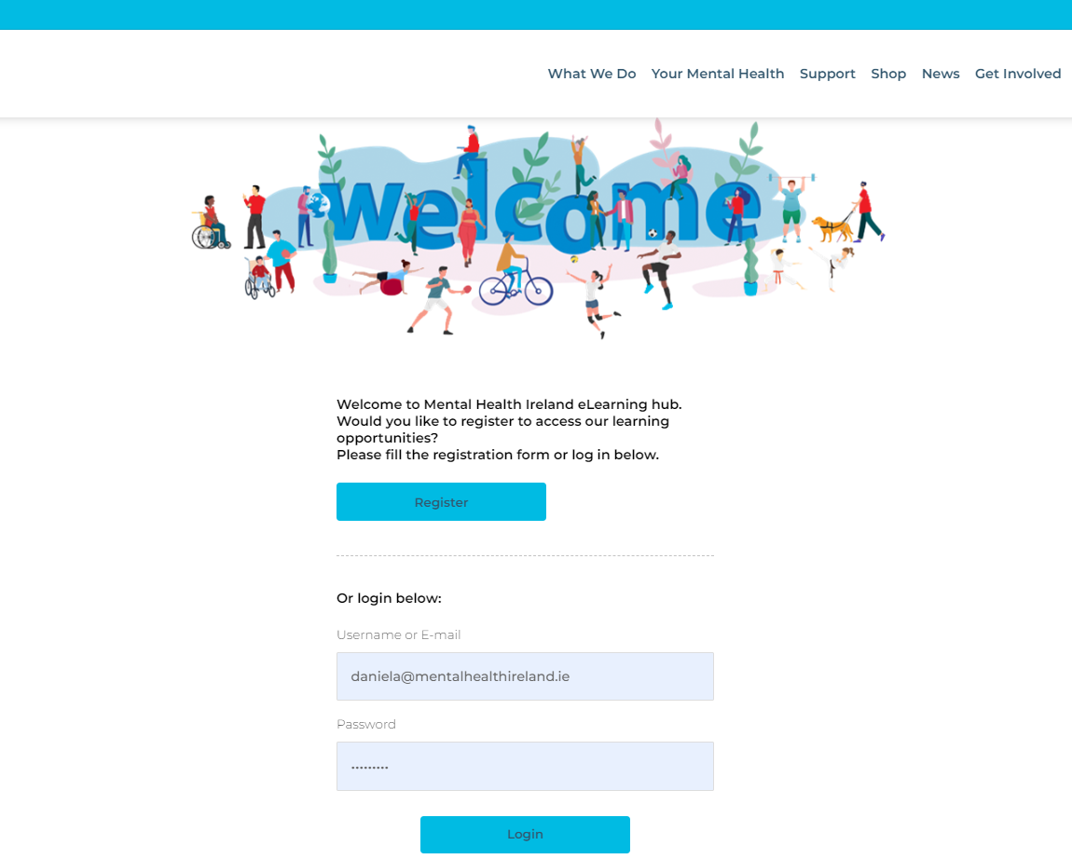
'Your First Steps to Mental health & Wellbeing in the workplace' eLearning module
Step 1 : go to the eLearning hub page
https://www.mentalhealthireland.ie/elearning/login/

Slide 13
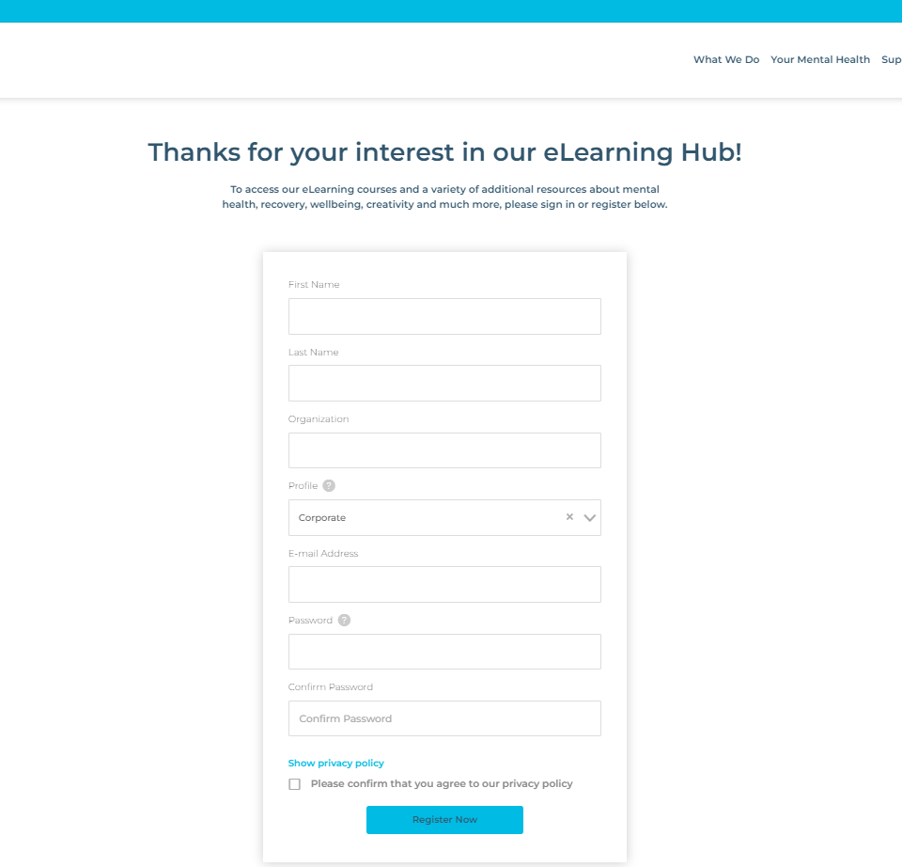
'Your First Steps to Mental health & Wellbeing in the workplace' eLearning module
Step 2 : Register
Choose 'Corporate' Profile
If you are already registered on Mental Health Ireland's website, we recommend you use a different email address for a new registration.

Slide 14

A huge thank you to the coproduction group who worked on the e-Module:
Daniela Monza – Project Lead and
Designer
Sonia Rennicks – Project Sponsor and
Coproduction Group
Maria Walsh-Healy – Coproduction Group
Georgina Lawless – Coproduction Group
Teresa Keane – Coproduction Group
Shane McHale – Coproduction Group

Slide 15


